Slide 1
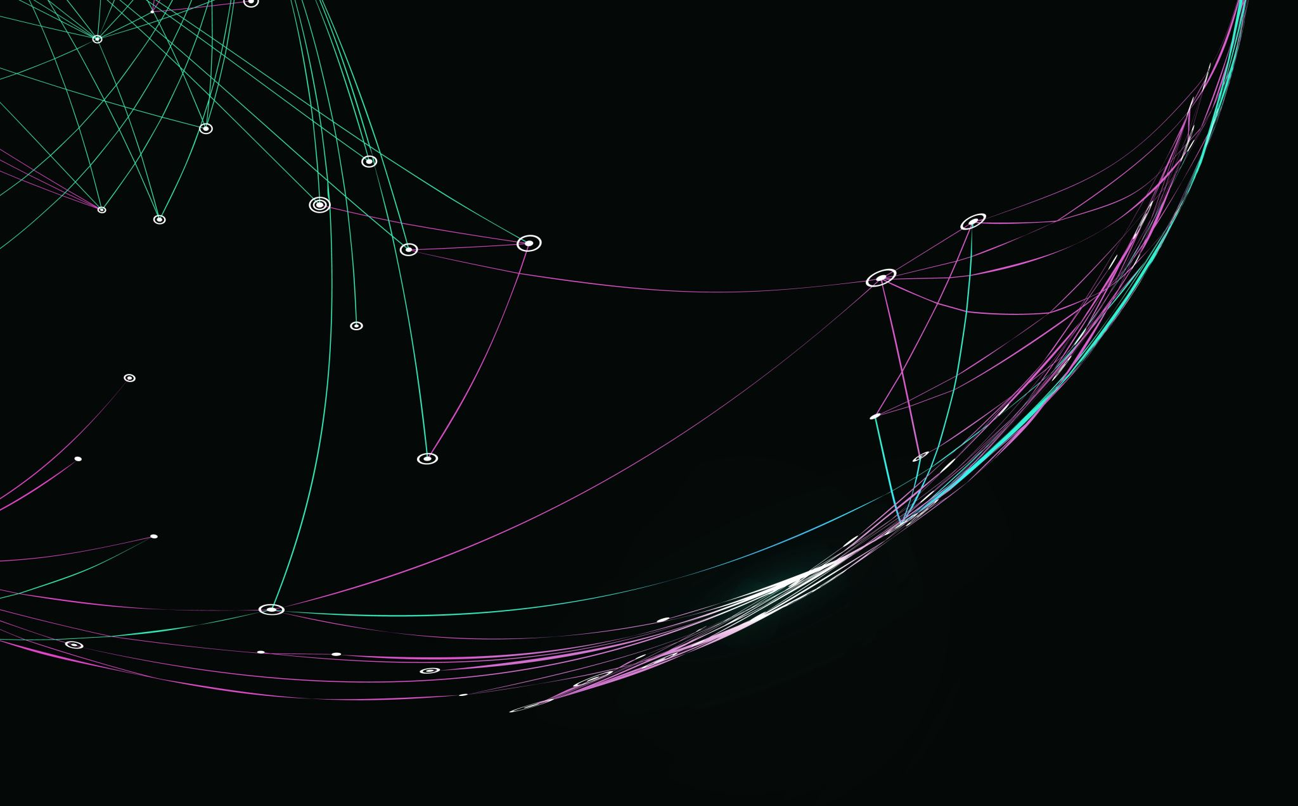

Project 1
Ana Oldham

Slide 2
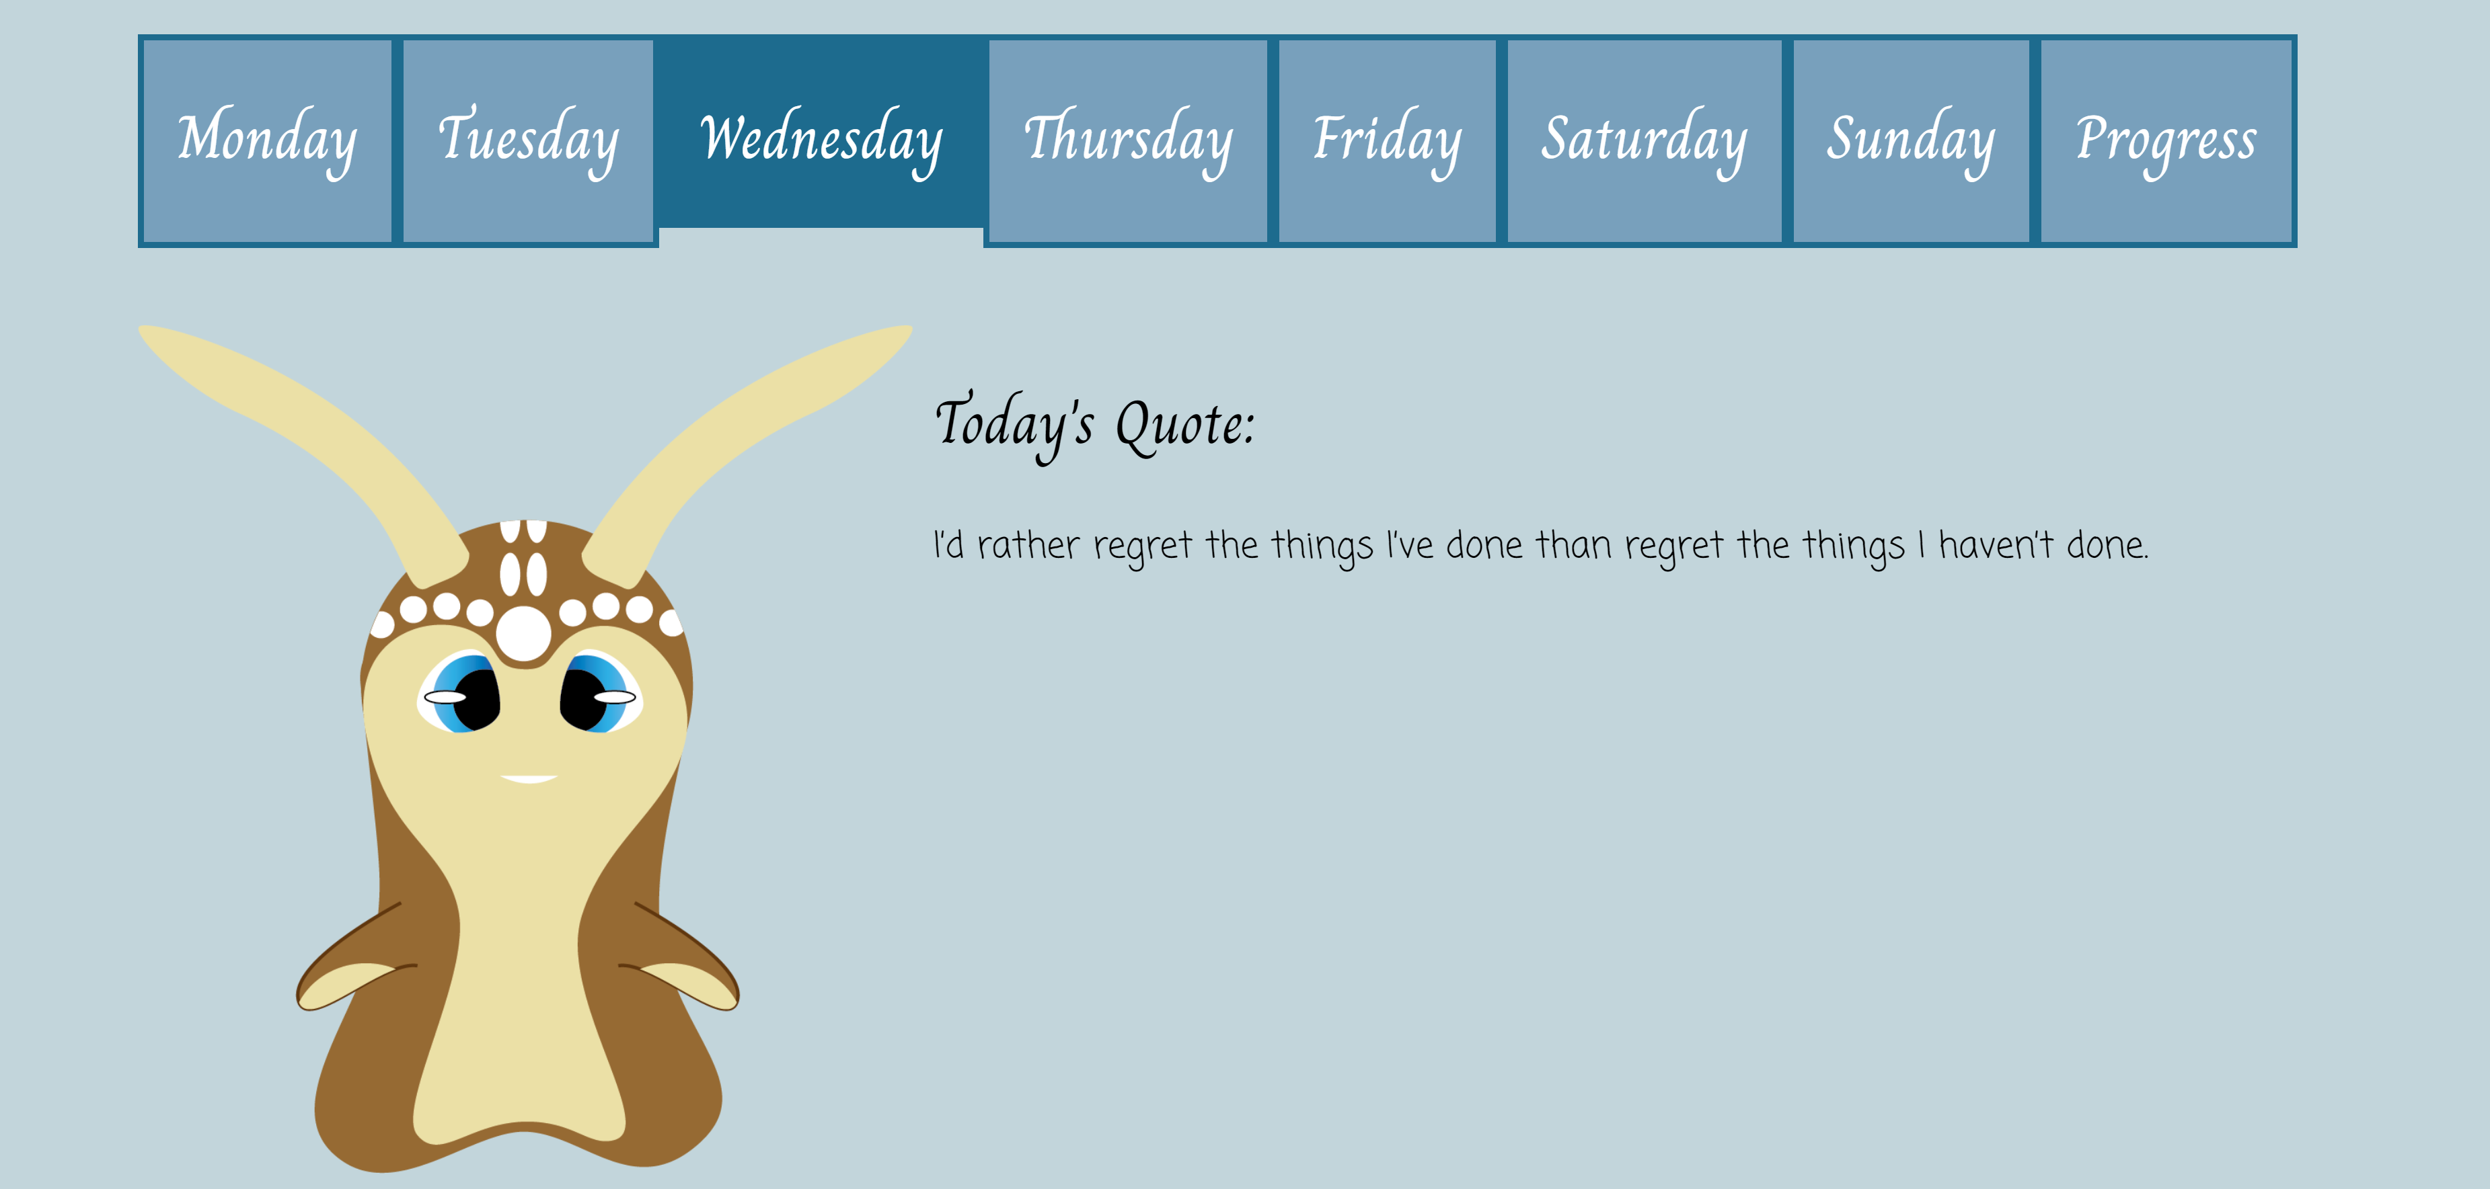
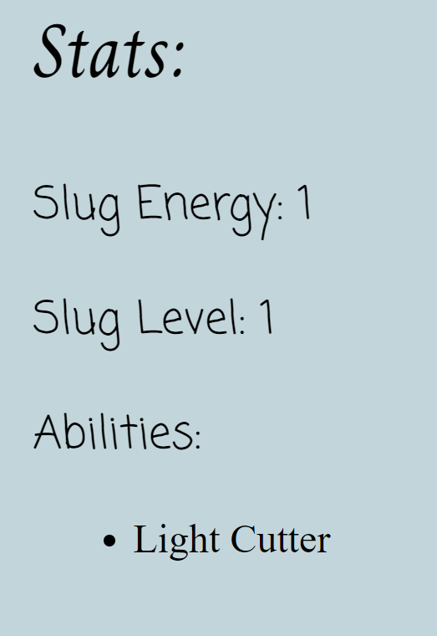
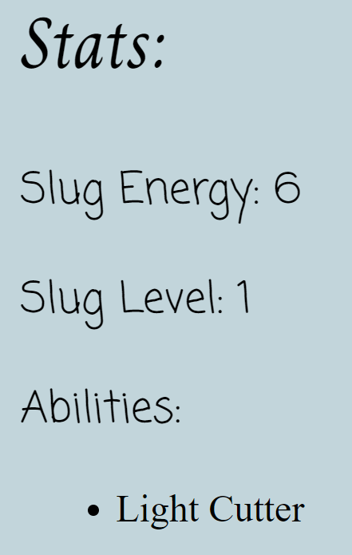
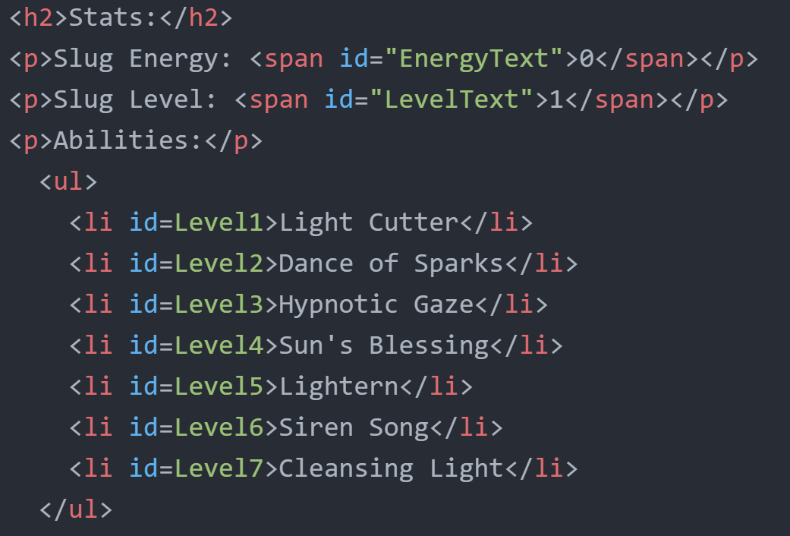


Objective:
Self-care menu
Stress, anxiety, depression
Reflective thinking patterns
Physical health
Social network
Organization
Leisure time / rest
Meditation
Incentive
Point system
Levels
Discovery

Slide 3
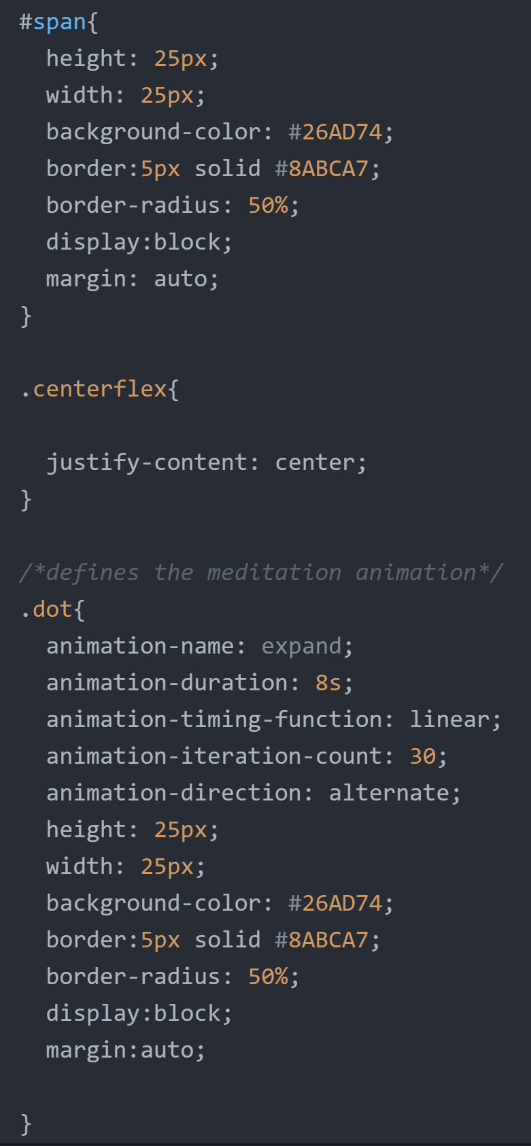
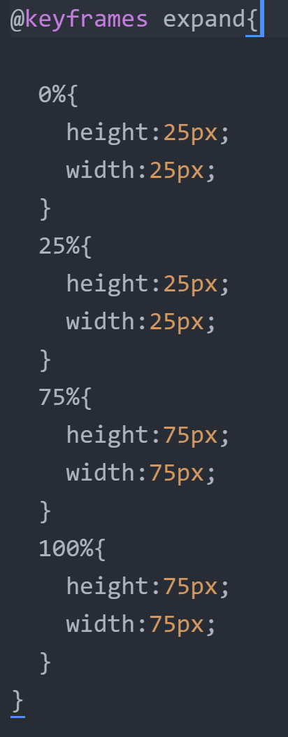
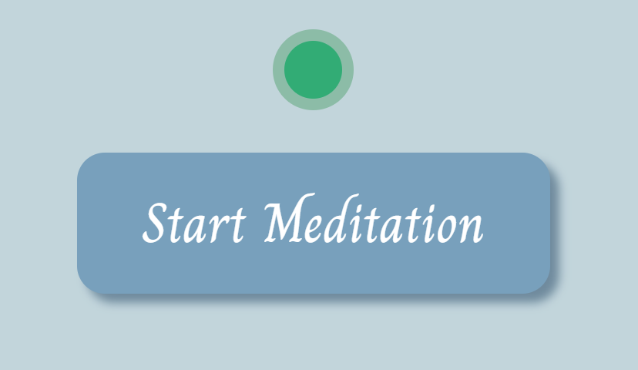
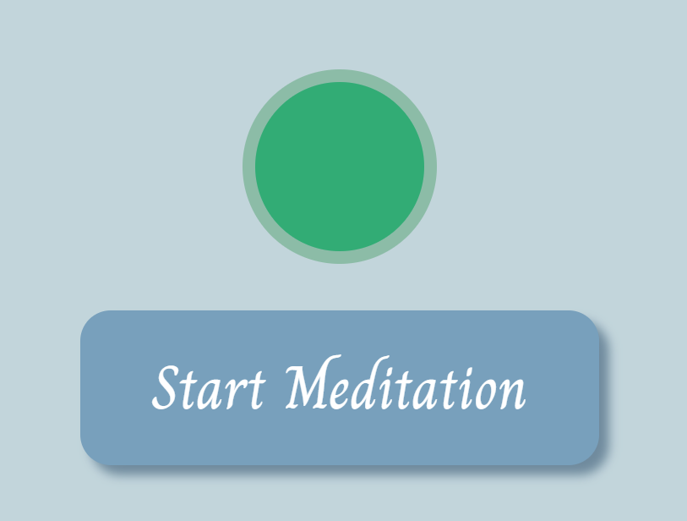

Most Challenging, Most Rewarding
Meditation circle
Animation
Circle = span
Timing: 5 sec, 5 min

Slide 4



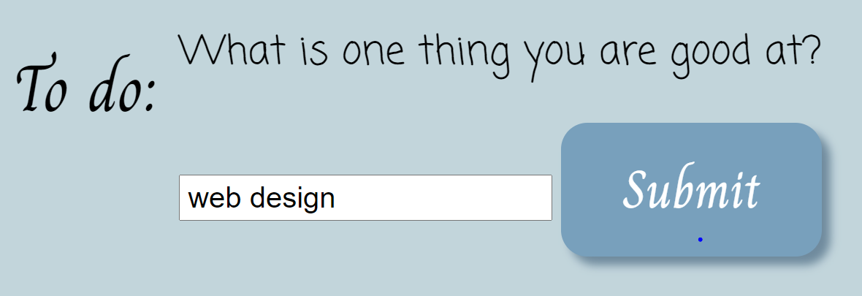


Reflective Thinking Patterns
Quote: new every day, each month(Date)
Fill-in questions (form)
Re-wires brain
Logs progress

Slide 5
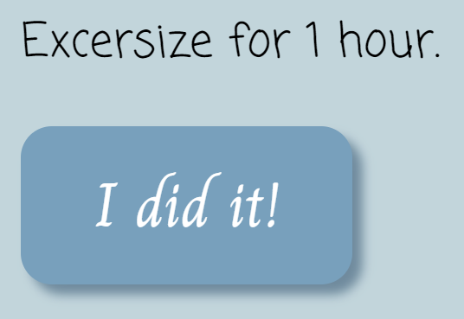
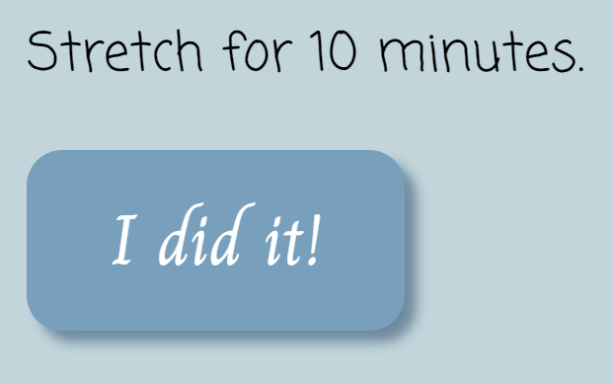
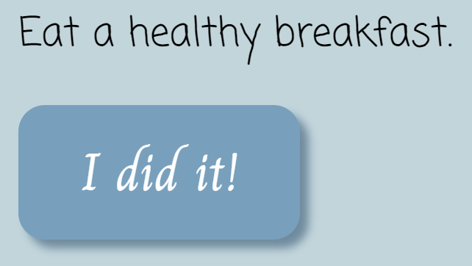
Physical Health
Endorphins
Self-esteem
Accomplishment
Exercise
Stretching
Healthy eating

Slide 6
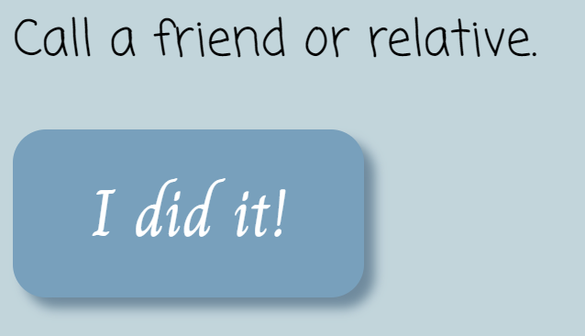
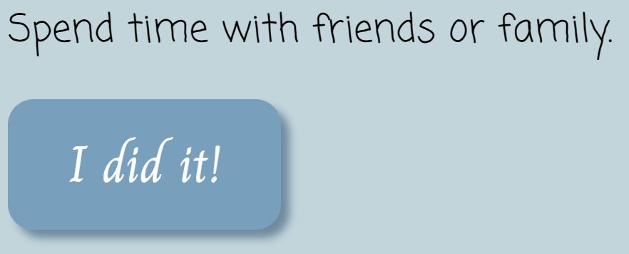
Social Network
Important w/depression
Not alone
Support group

Slide 7
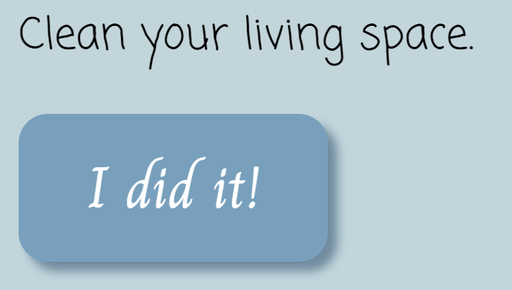
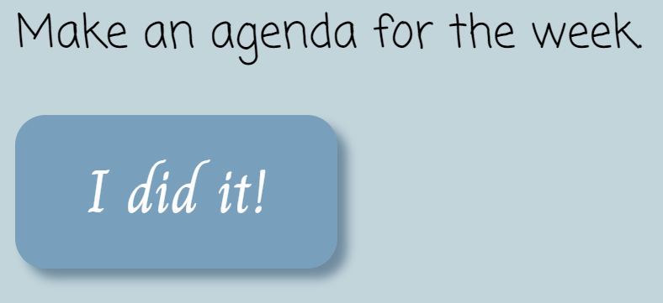
Organization
Time-management
Feelings of control
Decreases stress

Slide 8
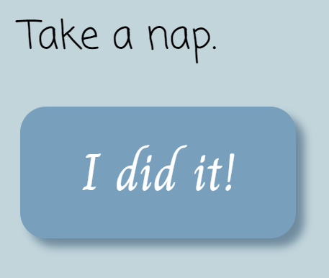
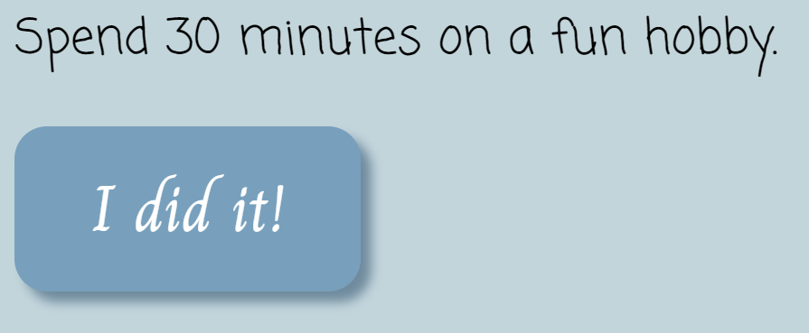
Redefining Leisure Time
Reduce feelings of guilt
Important part of mental maintenance
Rest & hobbies reduce stress
Limits / management

